Slide 1
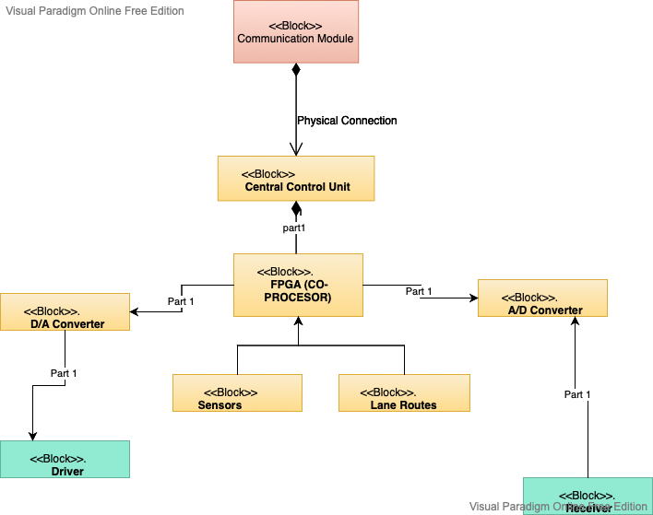
COMUNICATION MODULE

Slide 2
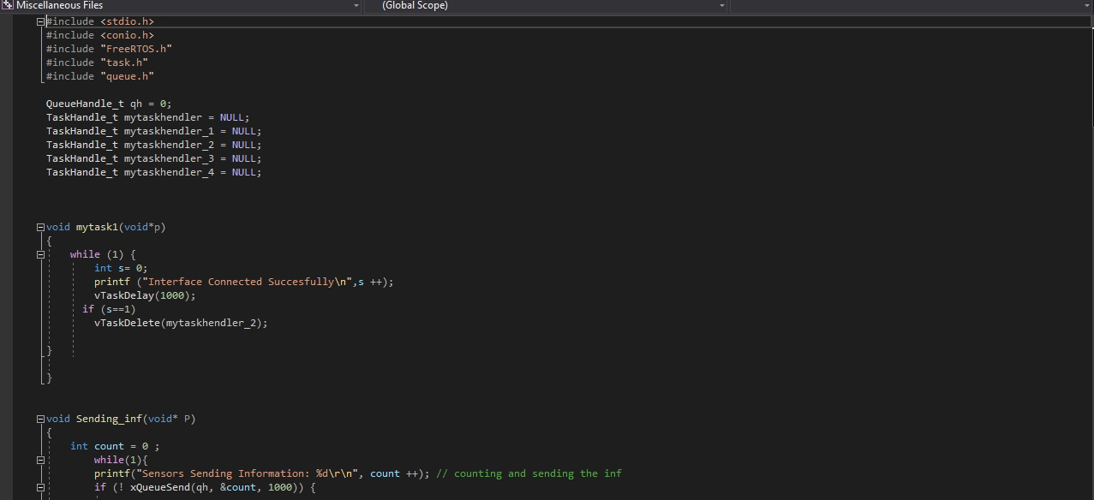
Interface and Taskhandlers

Slide 3
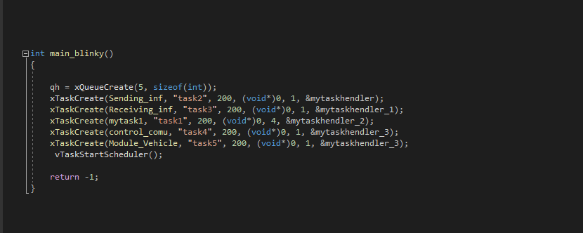
CREATING TASKS AND PRIORITIES

Slide 4
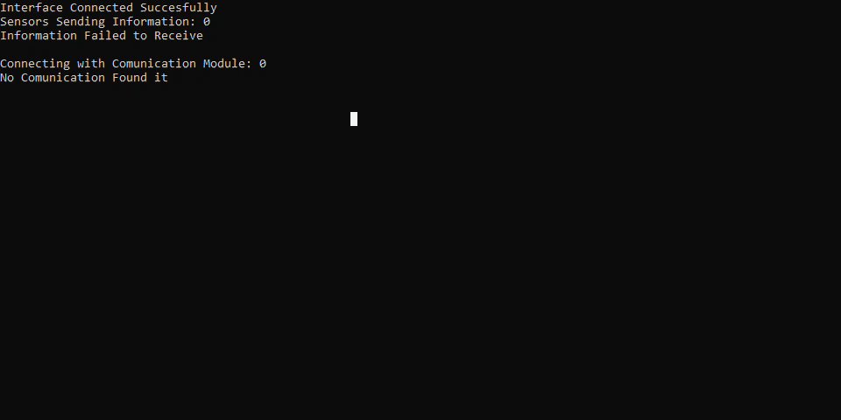
SIMULATION VIDEO

